Slide 1
MIPI Review
Zheng xie

Slide 2
CONTENT
MIPI CSI-2
Soc Arch
Synopsys MIPI IP
Check list

Slide 3
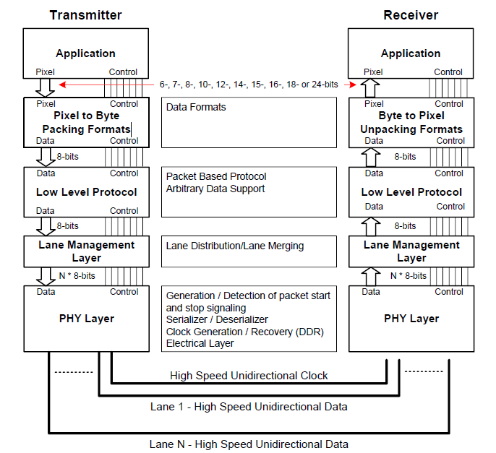
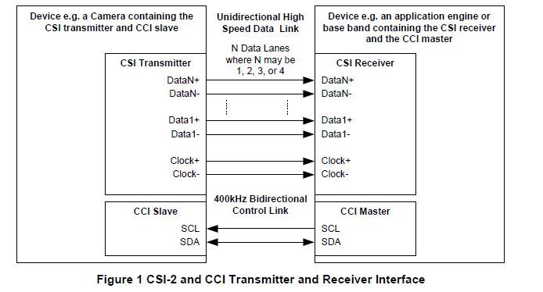
MIPI CSI-2
CSI-2 Protocol
TX&RX Interface

Slide 4
Soc Arch
Top Diagram
Estimate Perfomace
Interface

Slide 5
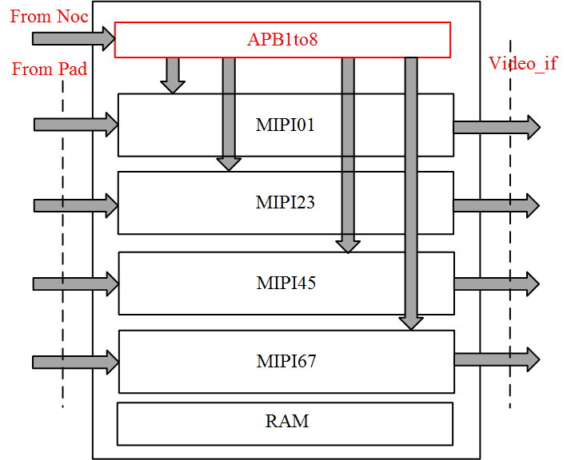
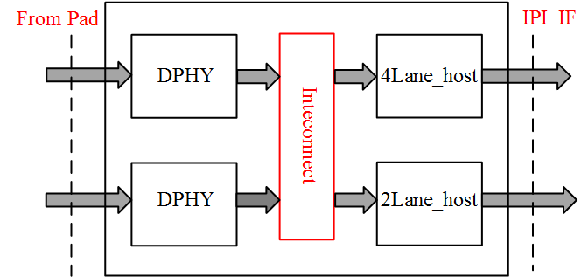
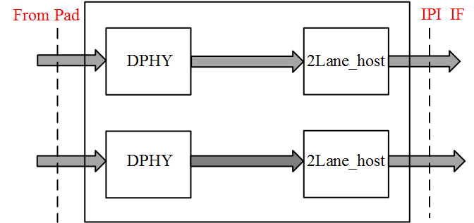
Top Diagram
SOC_TOP
Camera_support: 4~8
FOUR_LANE_MIPI
Case_0
Complexity, Hardware cost low!
Case_1

Slide 6
Performace

Slide 7
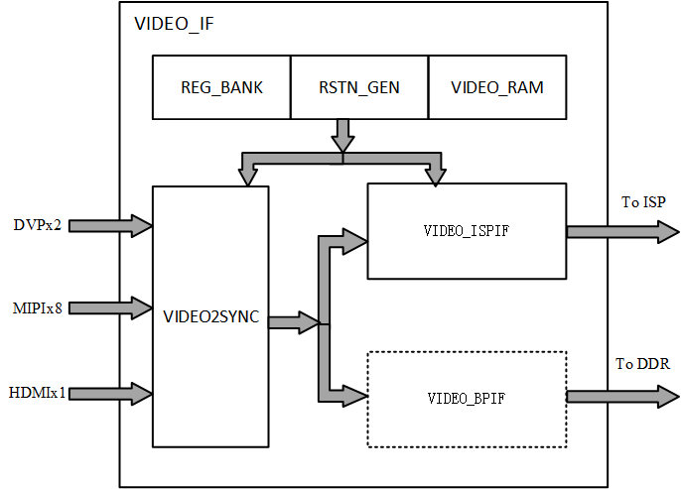
INTECONNECT
VIDEO_IF
Video2sync
Video_ispif: max 4K(4096x)
Video_bpif:
CCI <camera control interface>
From M7

Slide 8
Synopsys MIPI IP
Config
Interface
Interrupt
Verification
Syn&Formal
Programming Flow
Analog Test
Monitor Pin

Slide 9
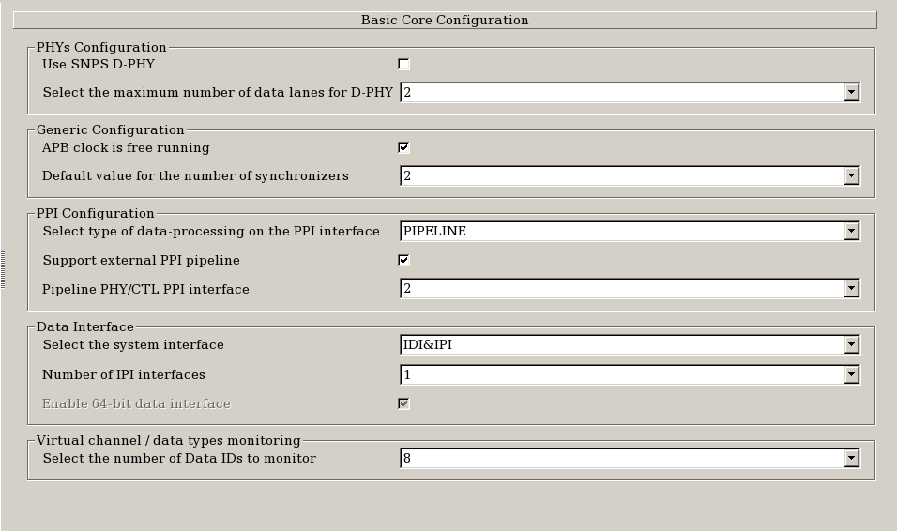
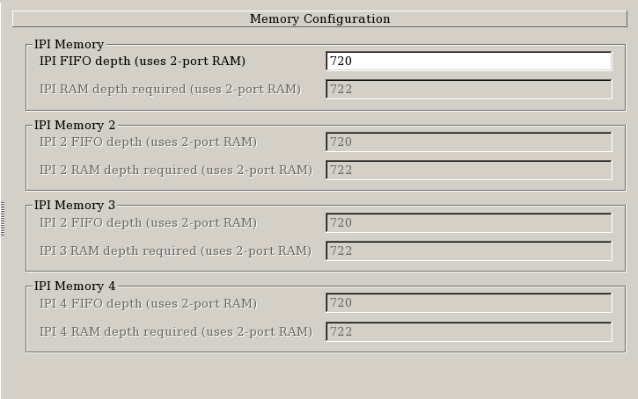
CONFIG
RAM: avoid underflow, at least one_line
Camera: 6kx24/64 =2250
Video: 1920x24/64 =720

Slide 10
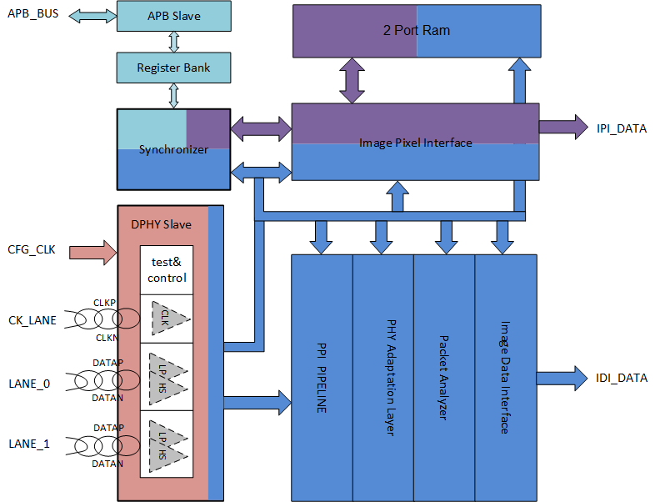
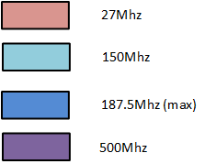
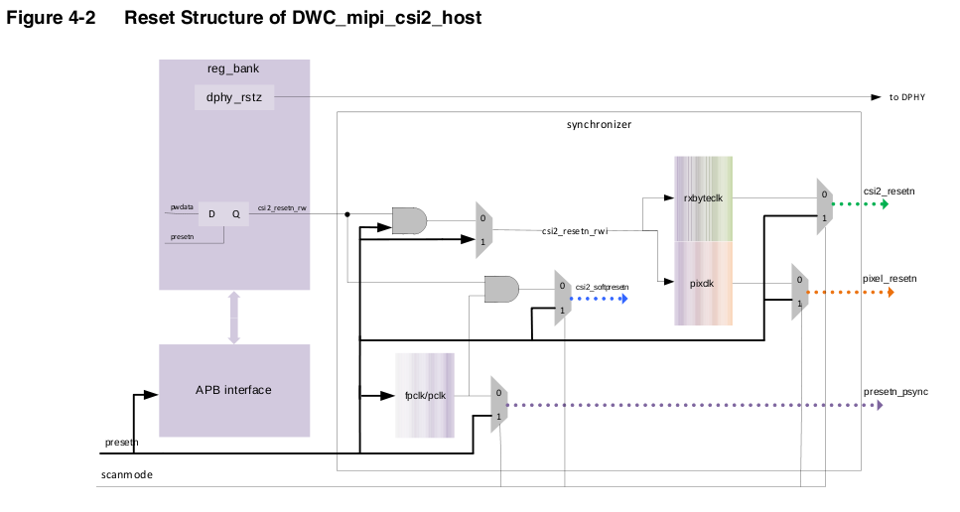
Interface

Slide 11
Interrupt
Interrupt pin
Not delivered in the IDI interface;
Informative only (masked)
Register
INT_ST_MAIN
INT_ST_<group>
INT_FORCE_<group>
INT_MSK_<group>

Slide 12
Verification
Ip Level <PASS>
Soc Level
<register R/W, IP connect>
Veloce Level
< different config>
Fpga Level

Slide 13
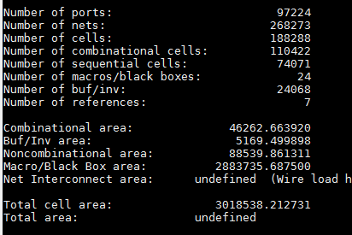
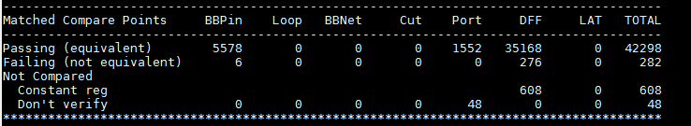
Syn&&Formal
Synthesis
RAM | 0.396 mm²
PHY | 2.488 mm²
Controller | 0.134 mm²
total | 3.018 mm²
Formality

Slide 14
Programming Flow
Start up DWC_mipi_csi2_host
Initialize DWC_mipi_csi2_host
Configure IPI
Start the HS Reception Mode
Detect Errors

Slide 15
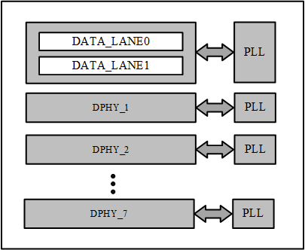
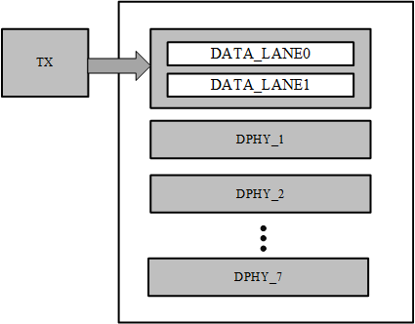
Analog Test
ATE TEST
Recommand
PHY2PHY

Slide 16
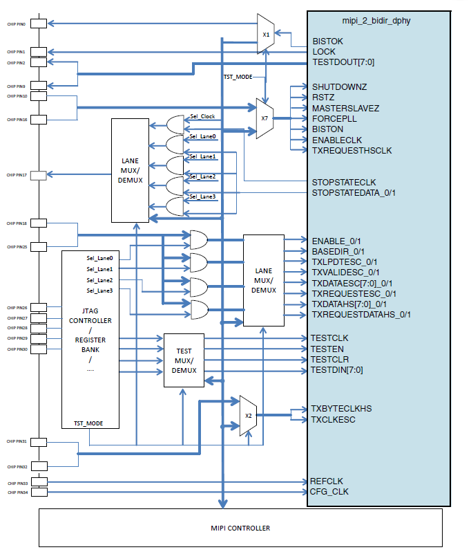
Monitor Pin

Slide 17
Check_list
IP_MIPI_checklist.xlsx

Slide 18
Q&A

